Slide 1
Java Streams
Thomas Dreßen
BitAix GmbH
März 2022

Slide 2
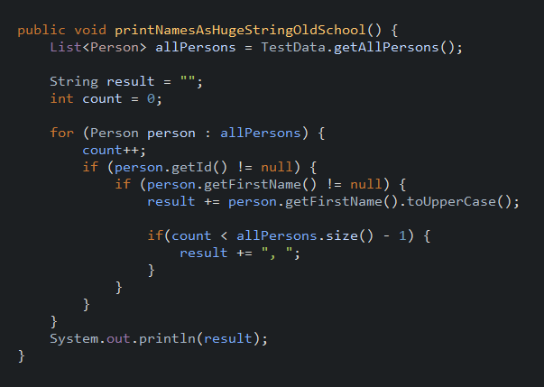

Slide 3
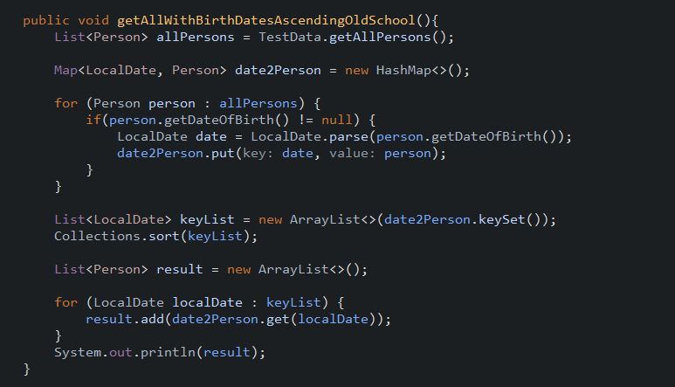

Slide 4

SELECT UPPER(first_name) FROM t_person
WHERE first_name IS NOT NULL
Database

Slide 5

personList.stream() filter(p -> p.getFirstname() != null)
map(p -> p.getFirstName().toUpperCase())
collect(Collectors.toList())
SELECT UPPER(first_name) FROM t_person
WHERE first_name IS NOT NULL
Database
Java VM

Slide 6
Streams
List<Person> personList = createPersonList()….
personList
.stream()
.filter() (intermediate operations)
.map()
.collect(); (terminal operations)

Slide 7
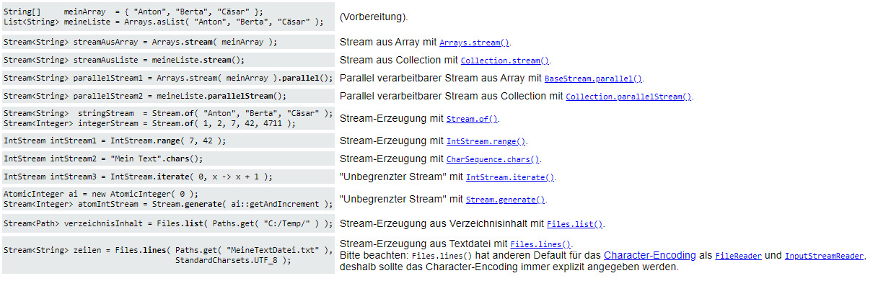
Create Streams Examples

Slide 8
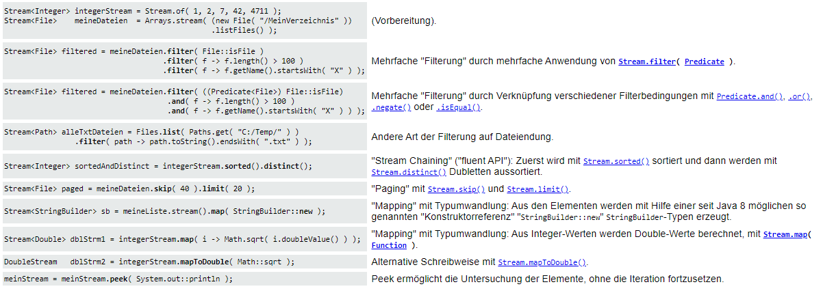
Intermediate Operations Examples

Slide 9
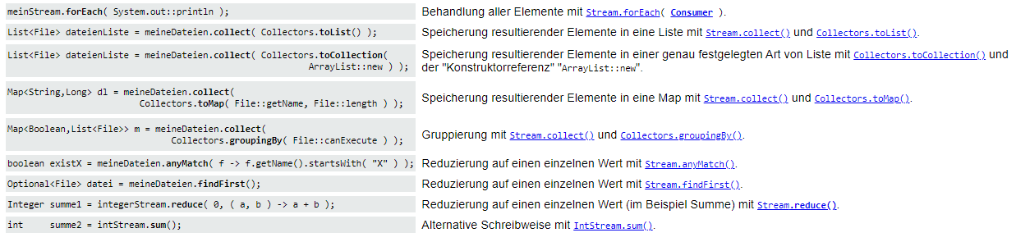
Terminate Operations Examples

Slide 10
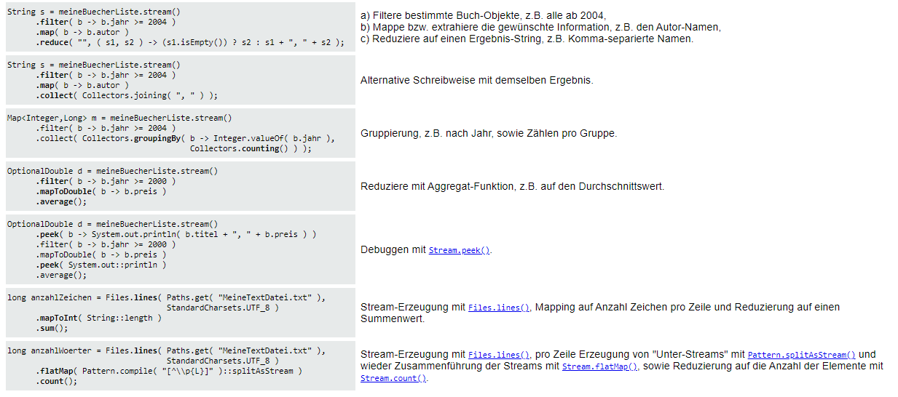
Filter Map Reduce Examples

Slide 11
Quelle
https://www.torsten-horn.de/techdocs/java-lambdas.htm

